Slide 1
Tight end fantasy football score ranges case study
Austin Crehan

Slide 2
Tight end fantasy football score ranges
Overview: Approximately 70 million people around the world played fantasy football this past year. The typical fantasy football lineup consists of at least one quarterback, two running backs, two wide receivers, and one tight end. Players score fantasy points for offensive feats such as catching the ball, gaining yards, and scoring touchdowns. The overwhelming majority of those 70 million fantasy players were faced with a similar question: who should I play at tight end? There are a multitude of factors that make the tight end position trickier than other positions when it comes to fantasy football. Tight ends are asked to block more frequently than running backs or wide receivers, inherently limiting the opportunity to score fantasy points. Additionally, teams often utilize a committee approach to the tight end position, further limiting the opportunity for one player to consistently score fantasy points. These factors compound and result in the "haves" and "have-nots" at the tight end position. If you have an elite tight end on your team, you instantly have a competitive advantage over your opponents.
Objective: To determine how much of an advantage elite tight ends are in fantasy football.
DATA
TOOLS
SKILLS
Player stats and contract data from the 2020 through 2022 NFL seasons obtained from NFL.com
Python 3
Jupyter Notebook
Pandas, Seaborn, Numpy, and Matplotlib libraries
Tableau
Data wrangling and cleaning
Exploratory analysis
Regression analysis
Machine learning
Cluster analysis
Geographic visualization

Slide 3
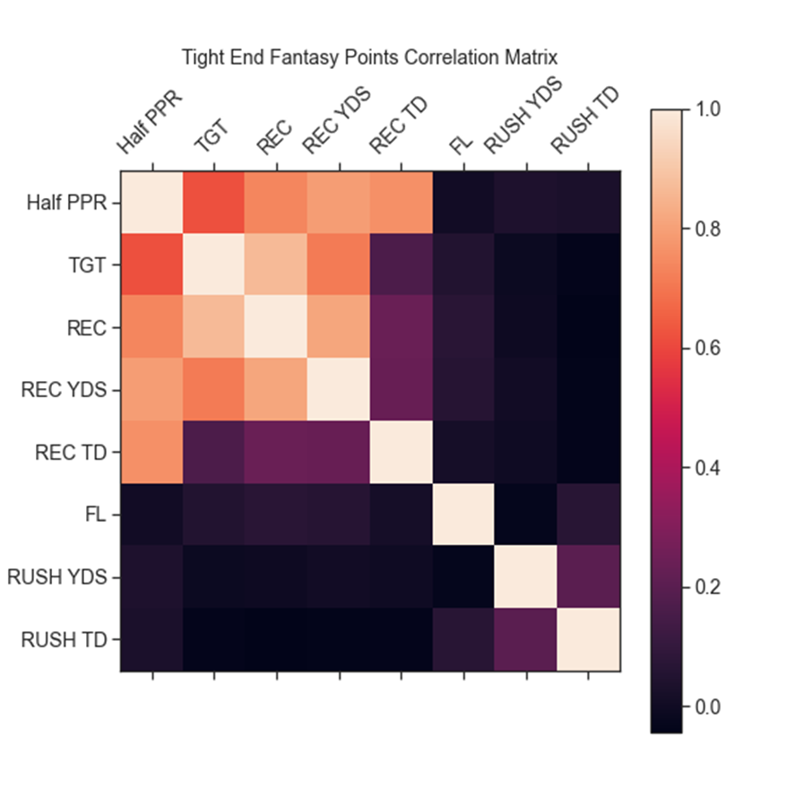
Exploratory analysis
For the sake of exploration, we begin by looking for linear relationships between variables
We found out there's a strong, positive correlation between tight end fantasy football scoring and targets, receptions, receiving yards, and receiving touchdowns, with receiving yards being the strongest
The strong, positive trend between tight end fantasy football scoring and receiving yards leads us to the following hypothesis: as a tight end's receiving yards increase, the fantasy points scored increase
Stats explanation:
Half PPR: Fantasy points scored in half point per reception (the most popular) scoring style
TGT: Passing targets
REC: Receptions (a player receives half a fantasy points per reception)
REC YDS: Receiving yards (a player receives one fantasy point per ten receiving yards)
REC TDS: Receiving touchdowns (a player receives six fantasy points per receiving touchdown)
FL: Fumbles lost (a player loses two fantasy points per fumble)
RUSH YDS: Rushing yards (a player receives one fantasy point per ten rushing yards)
RUSH TDS: Rushing touchdowns (a player receives six fantasy points per rushing touchdown)

Slide 4
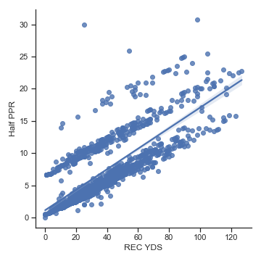
Exploratory analysis
As a tight end's receiving yards increase, the fantasy points scored increase
To test this hypothesis, we conducted a linear regression
The results show that tight end receiving yards explain about 83% of the trend in tight end fantasy points scored
The correlation coefficient indicates a strong, positive relationship between the variables
Interestingly, we see separate trend lines form around 0, 6, and 12 points – this is likely due to the impact scoring a touchdown has on fantasy scoring, as each touchdown is worth six points
As a linear regression doesn't fully explain the data, we will try another approach

Slide 5
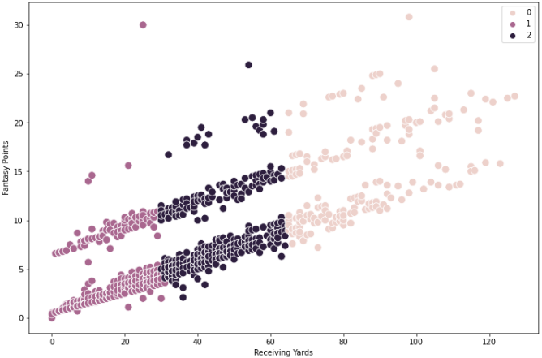
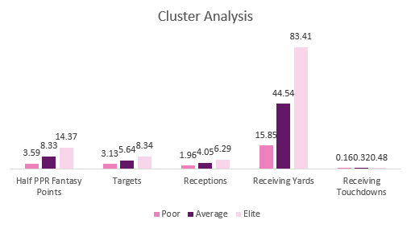
Cluster analysis
Because a linear regression wasn't enough to prove our hypothesis, we needed a non-linear approach
We conducted a cluster analysis – a cluster analysis groups data points into clusters
We can then compare clusters to uncover new patterns
Despite the presence of the three separate trend lines, our cluster analysis yielded three unique clusters based around receiving yards
This signifies that receiving yards are a more important driver of fantasy point scoring than receiving touchdowns

Slide 6
Tight end fantasy football score ranges recap
RESULTS
FURTHER ANALYSIS TO CONDUCT
Having an elite tight end gives you a 6.04-point advantage over opponents with an average tight end and a 10.78-point advantage over opponents with a poor tight end
According to FantasyOutliers.com, the average fantasy football team scores 90 points in a given week – for every 1% increase in score, winning percentage increases by 1.5%
Having a 10.78-point advantage over your opponent at the tight end position gives you a 16.17% higher likelihood of winning your match!
The initial hypothesis was proven correct: as a tight end’s receiving yards increase, the fantasy points scored increase, although not always in a linear fashion
Expand the sample size to include more NFL seasons (we could go back another 54 seasons)!
How have offenses evolved over the years and how does that impact fantasy scoring?
How have rule changes impacted scoring?
Conduct a multiple regression analysis to analyze the affect of multiple variables at once
Could we create a stronger model using targets, receptions, yards, and touchdowns?
LINKS
Github
Tableau

